Slide 1
CONTAINER STORAGE INTERFACE
References:
1.https://medium.com/google-cloud/understanding-the-container-storage-interface-csi-ddbeb966a3b
2.https://docs.redhat.com/en/documentation/openshift_container_platform/4.14/html/storage/using-container-storage-interface-csi#persistent-storage-csi-architecture_persistent-storage-csi

Slide 2
Container Storage Interface (CSI) is an initiative to unify the storage interface of Container Orchestrator Systems (COs) like Kubernetes, Mesos, Docker swarm, cloud foundry, etc. combined with storage vendors like Ceph, Portworx, NetApp etc.
Implementing a single CSI for a storage vendor is guaranteed to work with all COs.

Slide 3
CSI PLUGINS
Developed by storage providers
To establish a consistent interface between container orchestrators and storage solutions

Slide 4
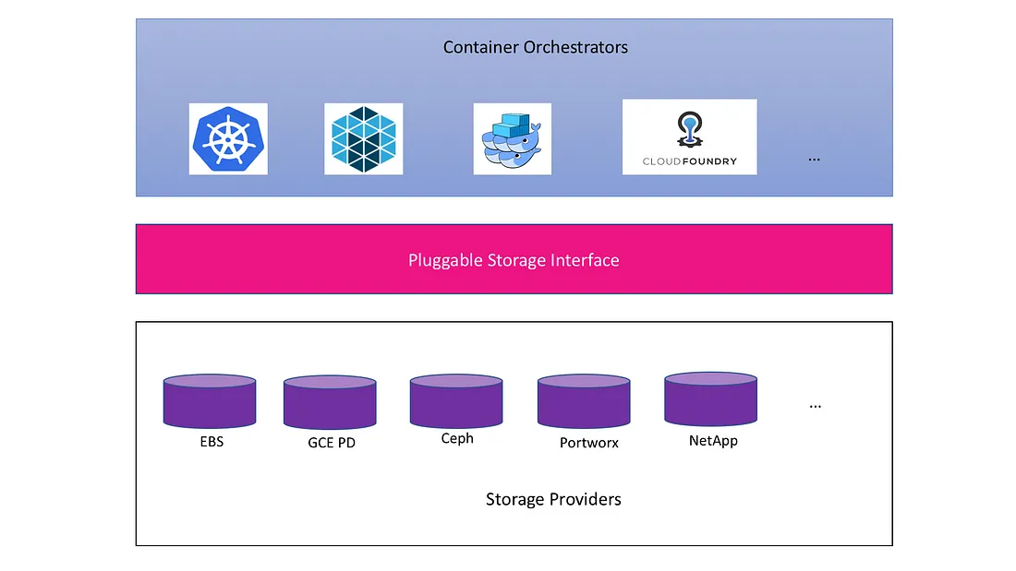

Slide 5
Before CSI
First release of CSI v0.1 was in December 2017.
Volume plugins were serving the storage needs for container workloads in case of Kubernetes.
Volume plugins are part of the COs core.

Slide 6
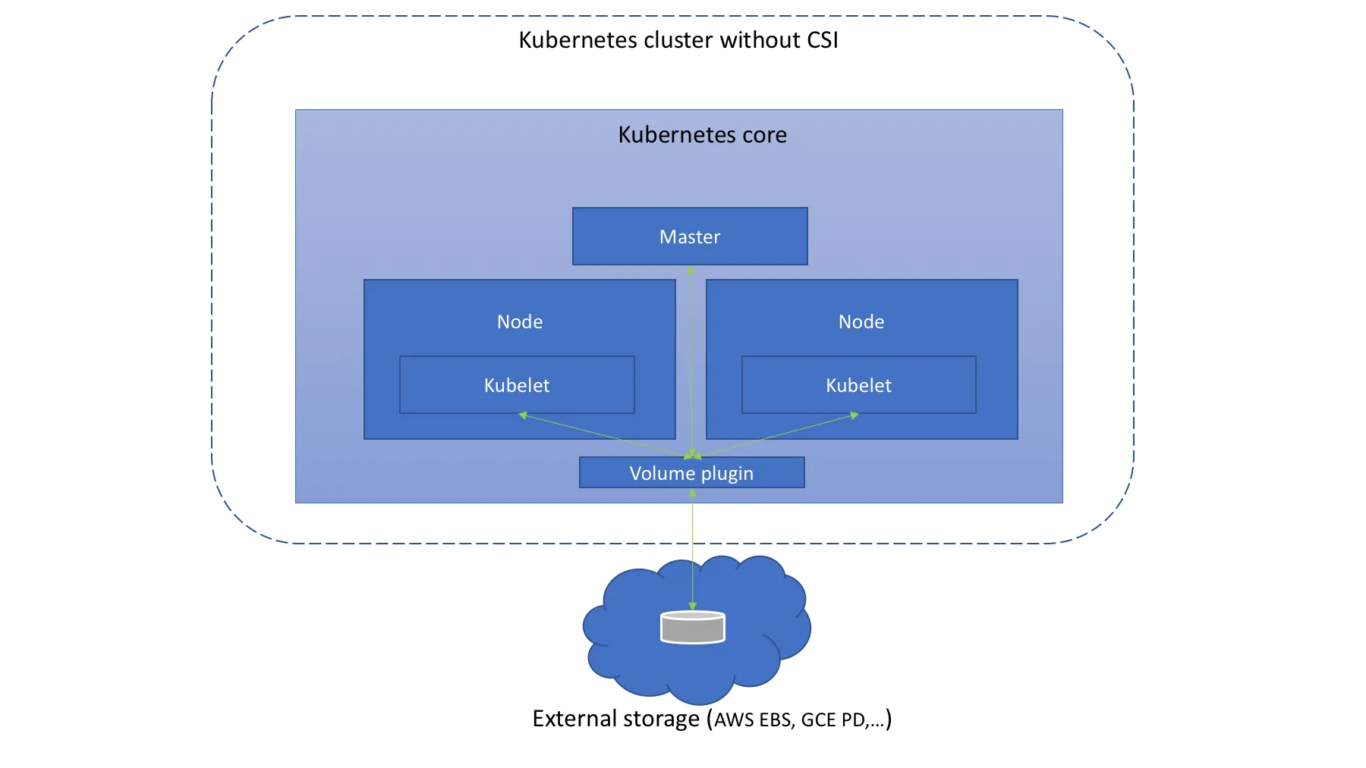

Slide 7
Drawbacks
Volume plugin development is tightly coupled and dependent on Kubernetes releases.
Kubernetes developers/community are responsible for testing and maintaining all volume plugins, instead of just testing and maintaining a stable plugin API.
Bugs in volume plugins can crash critical Kubernetes components, instead of just the plugin.
Volume plugins get full privileges of kubernetes components (kubelet and kube-controller-manager).

Slide 8
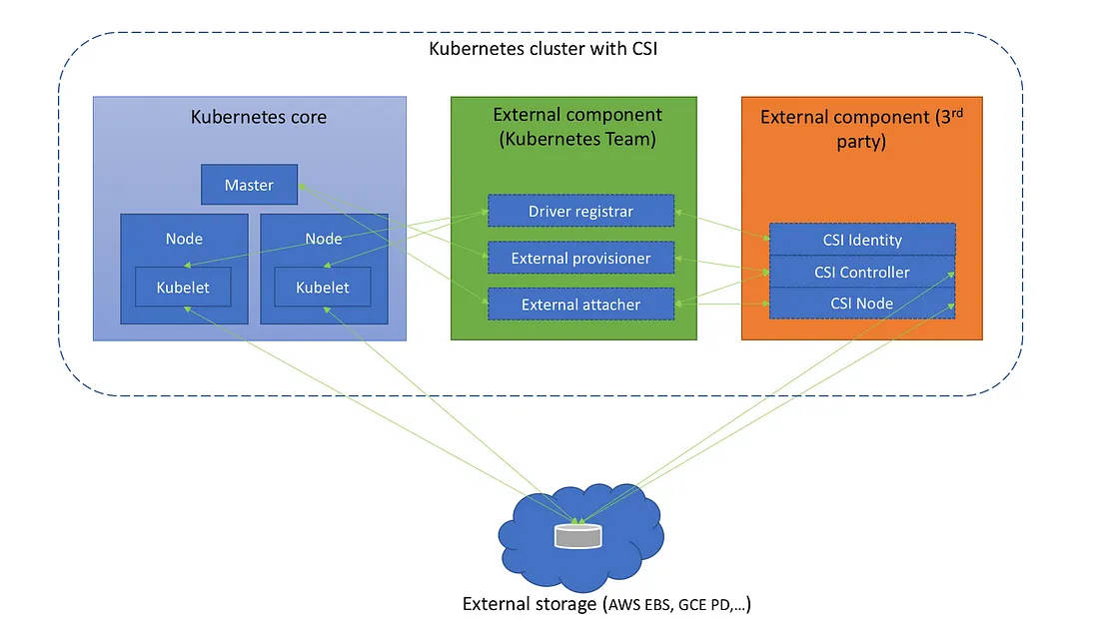
CSI Intro

Slide 9
Kubernetes External components
Released by Kubernetes team
Not part of the core
Can interact with vendor implemented external components.
External components can communicate to each other over gRPC on domain sockets.
Completely implemented and maintained by the Kubernetes team

Slide 10
Driver registrar
  Sidecar container that registers the CSI driver with kubelet, and adds the drivers custom NodeId to a label on the Kubernetes Node API Object.
  It does this by communicating with the Identity service on the CSI driver and also calling the CSI GetNodeId operation.
External provisioner
  Sidecar container that watches Kubernetes PersistentVolumeClaim objects and triggers CSI CreateVolume and DeleteVolume operations against a driver endpoint.
External attacher
  Sidecar container that watches Kubernetes VolumeAttachment objects and triggers CSI ControllerPublish and ControllerUnpublish operations against a driver endpoint

Slide 11
Storage vendor/3rd-party external component
Vendor specific implementation.
Each vendor should implement their respective APIs into gRPC service functions. E.g. Implementation of GCE PD, Ceph, etc.
CSI Identity
  Identifying the plugin service, making sure it’s healthy, and returning basic information about the plugin itself.
CSI Controller
  Controlling and managing the volumes, such as: creating, deleting, attaching/detaching, snapshotting, etc.
CSI Node
  Controlling volume’s action in the kubernetes node

Slide 12
CSI ARCHITECTURE IN OPENSHIFT
CSI drivers are typically shipped as container images.
Containers are not aware of OpenShift Container Platform where they run.
To use CSI-compatible storage back end in OpenShift Container Platform, the cluster administrator must deploy several components that serve as a bridge between OpenShift Container Platform and the storage driver.
Different storage backends-multiple CSI drivers
Each driver needs its own
  External controllers deployment and
  Daemon set with the driver and CSI registrar.

Slide 13
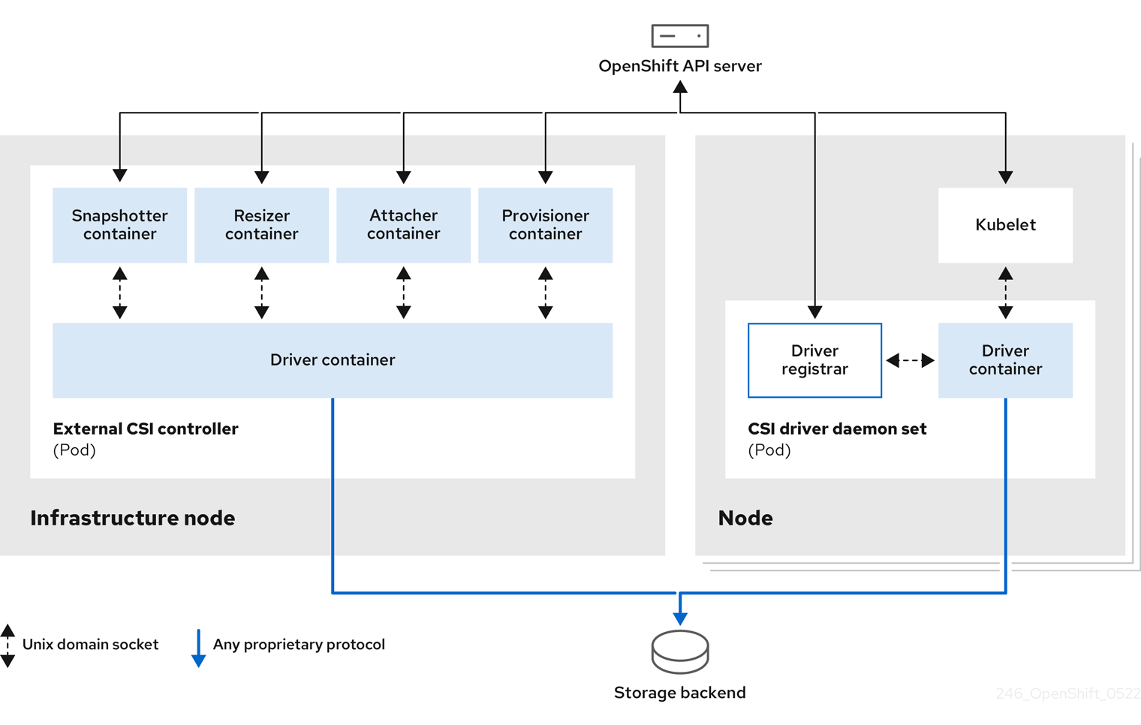

Slide 14
External CSI controllers
External CSI controllers is a deployment that deploys one or more pods with five containers:
  The snapshotter container watches VolumeSnapshot and VolumeSnapshotContent objects and is responsible for the creation and deletion of VolumeSnapshotContent object.
  The resizer container is a sidecar container that watches for PersistentVolumeClaim updates and triggers ControllerExpandVolume operations against a CSI endpoint if you request more storage on PersistentVolumeClaim object.

Slide 15
External CSI controllers
An external CSI attacher container translates attach and detach calls from OpenShift Container Platform to respective ControllerPublish and ControllerUnpublish calls to the CSI driver.
An external CSI provisioner container that translates provision and delete calls from OpenShift Container Platform to respective CreateVolume and DeleteVolume calls to the CSI driver
A CSI driver container.

Slide 16
External CSI controllers
The CSI attacher and CSI provisioner containers communicate with the CSI driver container using UNIX Domain Sockets, ensuring that no CSI communication leaves the pod.
The CSI driver is not accessible from outside of the pod.

Slide 17
CSI driver daemon set
Runs a pod on every node.
Allows OpenShift Container Platform to mount storage provided by the CSI driver to the node and use it in user workloads (pods) as persistent volumes (PVs).
Pod with the CSI driver installed contains the following containers:
  A CSI driver registrar, which registers the CSI driver into the openshift-node service running on the node.
  A CSI driver.
    The CSI driver deployed on the node should have as few credentials to the storage back end as possible.
    OpenShift Container Platform will only use the node plugin set of CSI calls such as NodePublish/NodeUnpublish and NodeStage/NodeUnstage, if these calls are implemented.
The openshift-node process running on the node then directly connects with the CSI driver using the UNIX Domain Socket available on the node.

